Slide 1

Gokula Krishna Tavva
Undergraduate student, Department of Mechanical Engineering, BITS Pilani, Rajasthan, India
Aug 1st , 2025

Slide 2
About Me
Background
I grew up in a diverse cultural environment, having been born in Vijayawada, India, and spending my childhood in cities including Bengaluru and Hyderabad.
Outside academics & research, I enjoy spending time working out, playing table-tennis, photography, playing the guitar, and meeting new people from a variety of different cultures.
Academic Life and Extracurriculars
Final year Mechanical Engineering student at BITS Pilani (CGPA: 9.22).
My goal remains to pursue a career in Aerospace Engineering. This field captivated me since I was a child. High-speed aerodynamics, turbulence modelling, and CFD are topics I’m keen to explore at this moment.
Team Captain, Inspired Karters Gravity: Led technical operations, managerial operations, logistics, and design for a national-level electric race vehicle project. We finished in the top-10 in our 1st attempt at this category.
Tanish Samanta, Gokula Krishna Tavva, Chennu Ranganayakulu

Slide 3
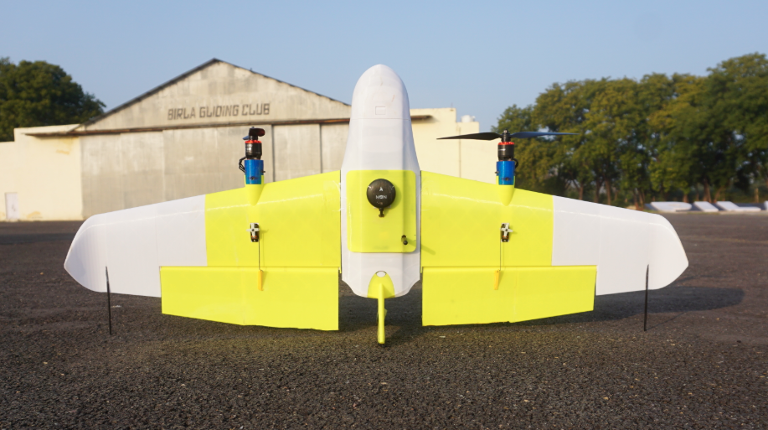
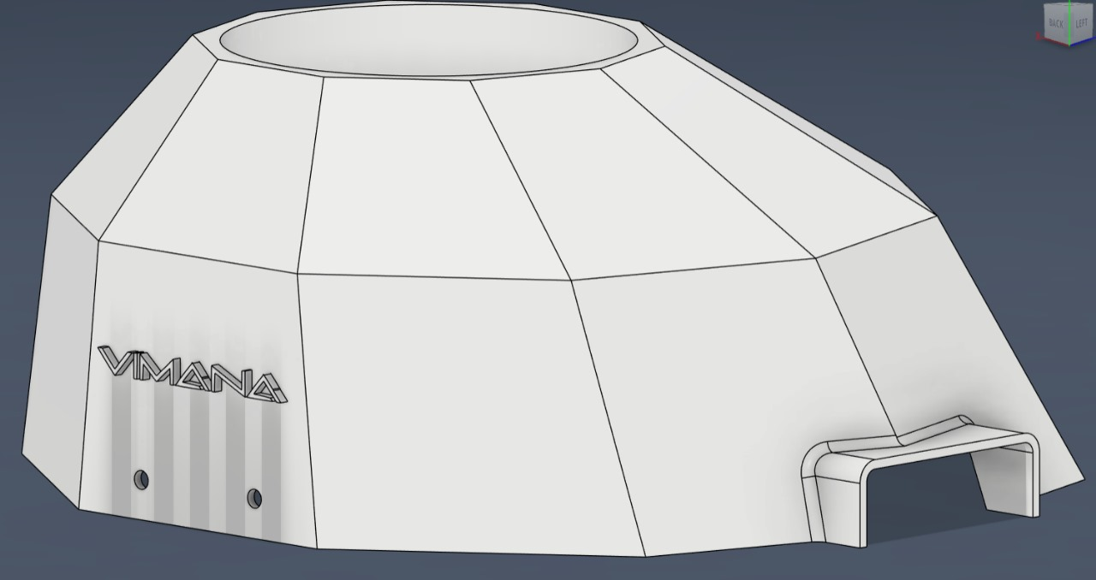
Professional Projects
Vimana Aerotech
Description:
Assisted in the development of a tail-sitter drone designed for long-duration survey missions with almost 4 times the flight time of conventional multi-copters with similar capacity and payload.
Utilized rapid prototyping, testing each iteration with 3D-printed components.
Contributed to designing custom hatches, covers, and motor mounts for an in-house manufactured hexacopter.
Key Results and Progress:
70+ Minute Endurance & 100+ KM Range: Cover vast areas in a single flight.
60% Lower Cost: Sovereign, affordable technology built in-house.

Slide 4
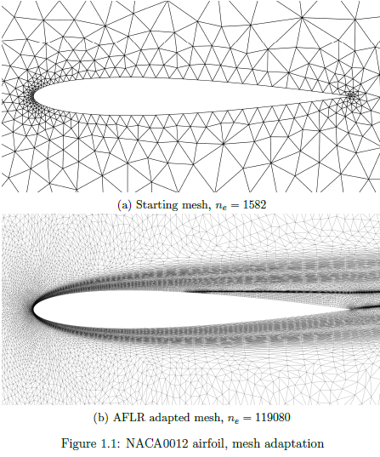
Research Projects
Development of 3D mesh generator for aerodynamic flows
Objectives:
Developing a 3D mesh generator utilizing metric-based anisotropic adaptation to enhance accuracy and efficiency in Finite Element Method solvers for aerodynamic flow simulations.
Implementing solution-driven error estimation methods, including adjoint-based and Hessian-based techniques, to guide adaptive mesh refinement, ensuring optimal mesh quality and convergence rates.
Skills: Python & Engineering math implementation
Status:
Undergraduate thesis – under progress

Slide 5
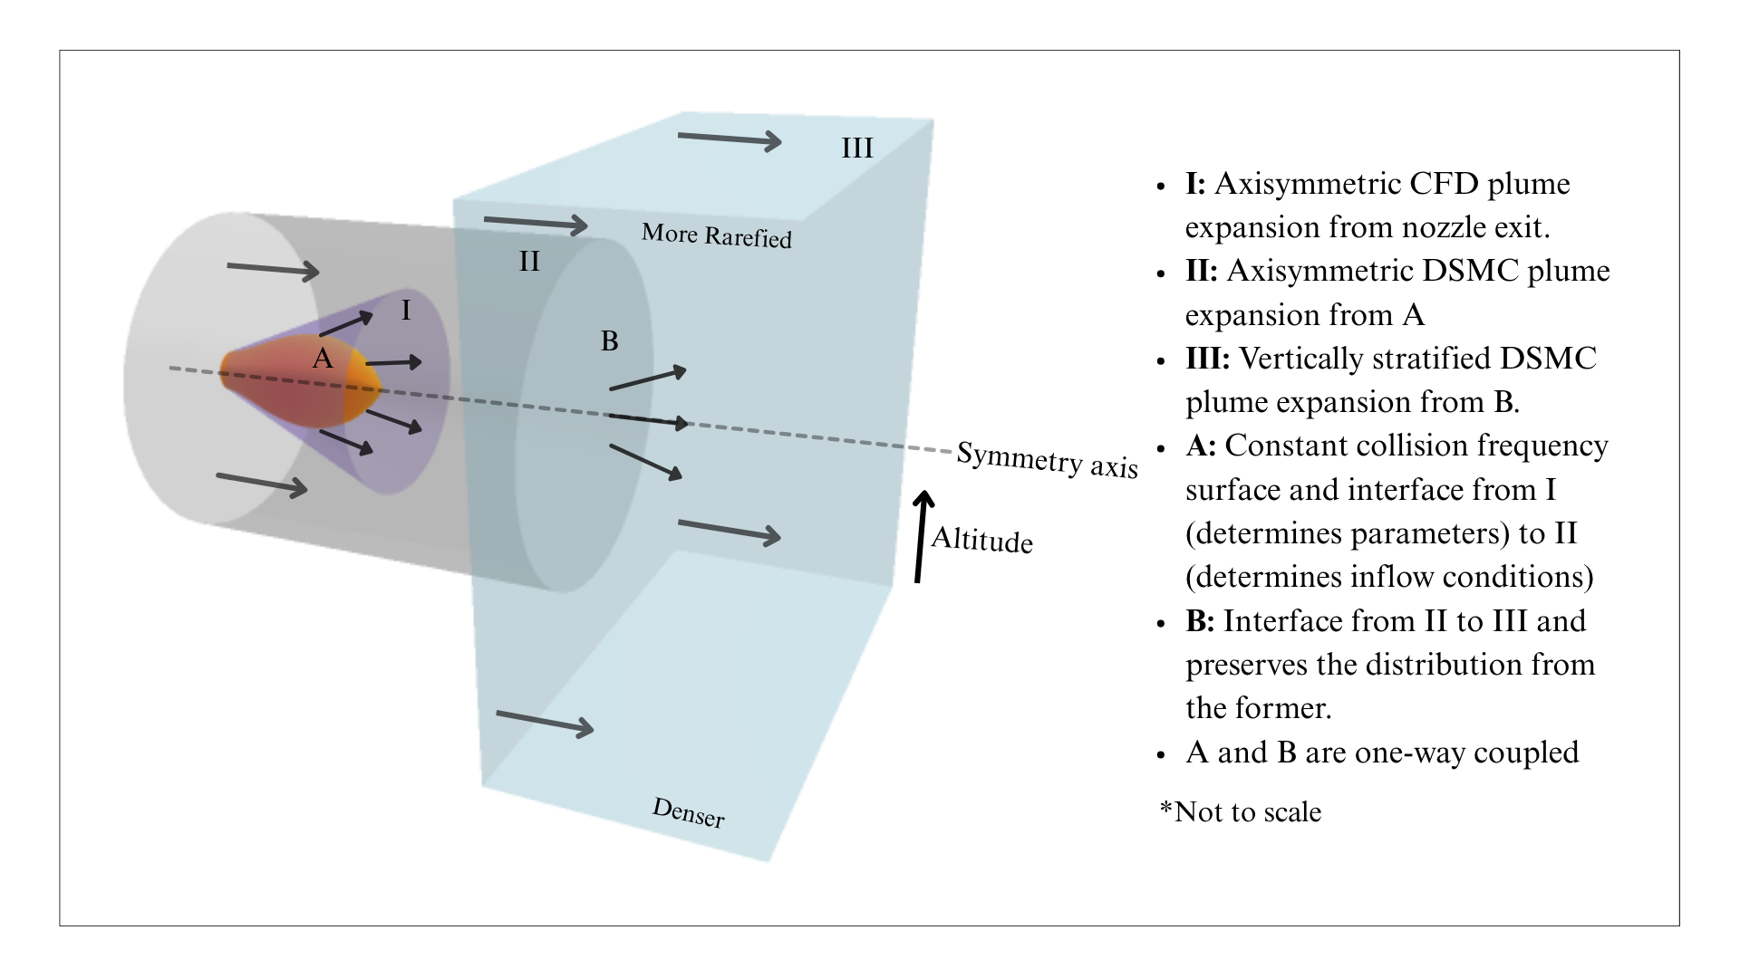
Research Projects
Hybrid CFD/DSMC modelling of high-altitude rocket plumes
Objectives:
Developing a hybrid simulation workflow for Falcon 9 exhaust plume expansion in the thermosphere. Incorporating viscous and thermochemical effects for enhanced accuracy.
Exhaust plume expansion are known to cause ionospheric disturbances due to rocket-induced atmospheric waves. This study is pivotal in understanding them accurately and in an easier way.
Solver: ANSYS Fluent for CFD analysis of continuum regions and DSMC for rarefied regions.
Status:
Under progress – accepted for a int. conf.

Slide 6
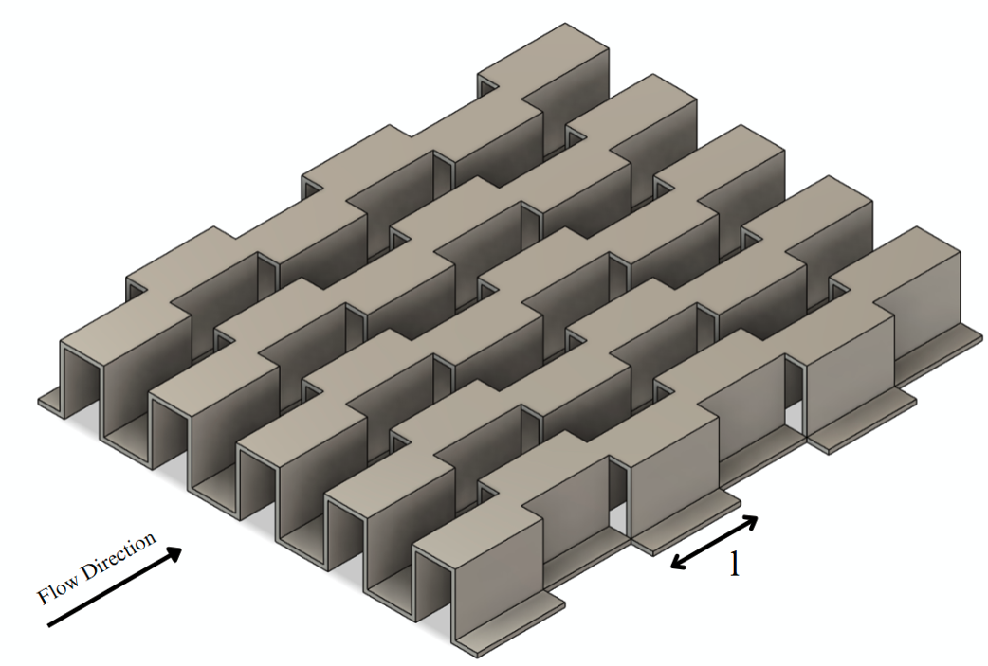
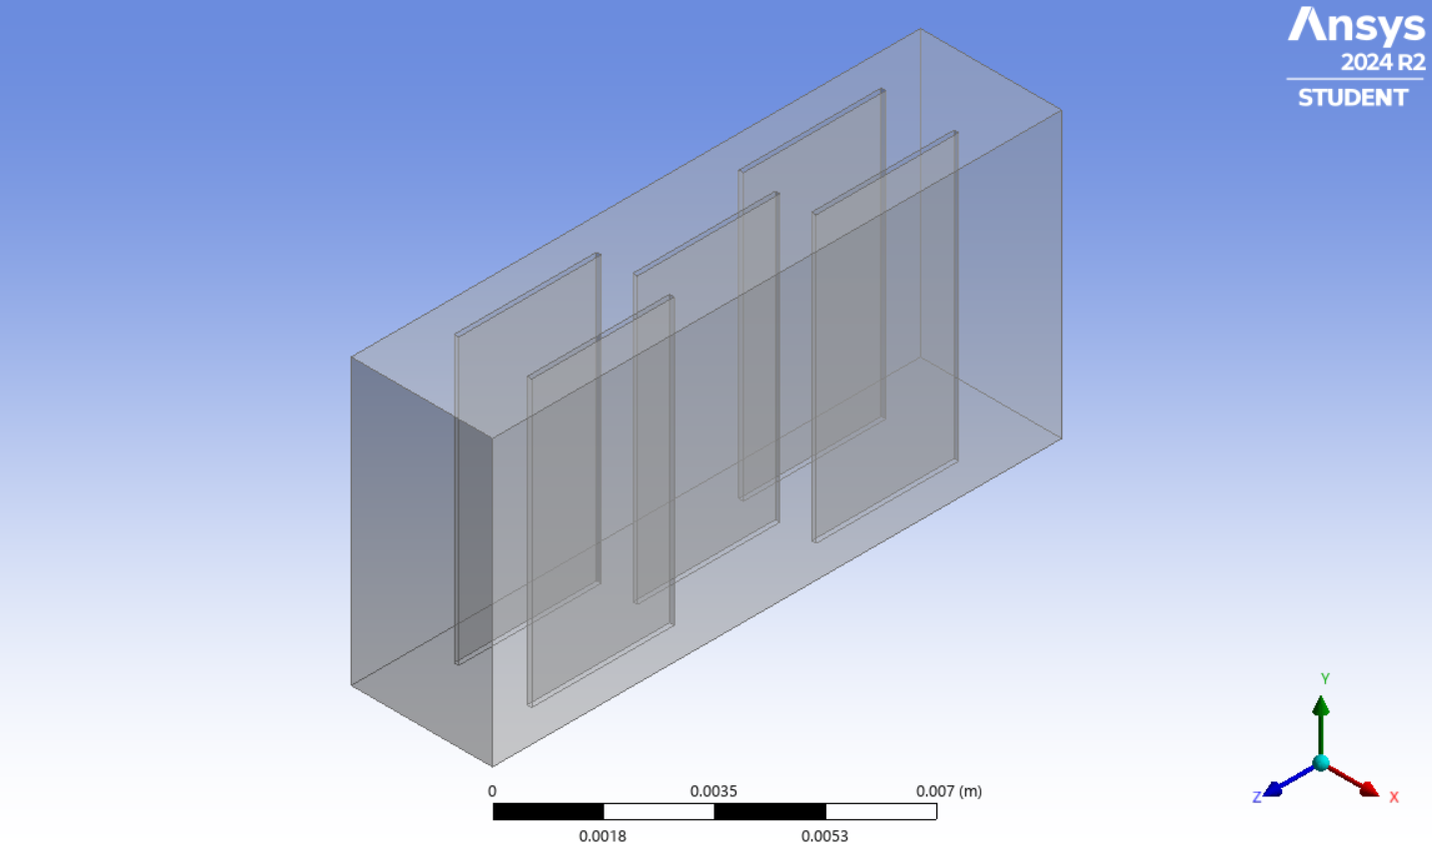
Research Projects
CFD Analysis of Offset-Strip Fins
Objectives:
Develop correlations for Colburn j-factor and friction factor f based on fin geometry.
Analyze the effects of varying lance lengths on heat transfer and pressure drop.
CFD Solver: ANSYS Fluent for CFD analysis.
Key Results:
Established new correlations for j and f factors that are within 11% of experimental values.
Identified the individual effect of each geometric parameter on fin performance
Presented at the ICGTME – 2025 conference.

Slide 7
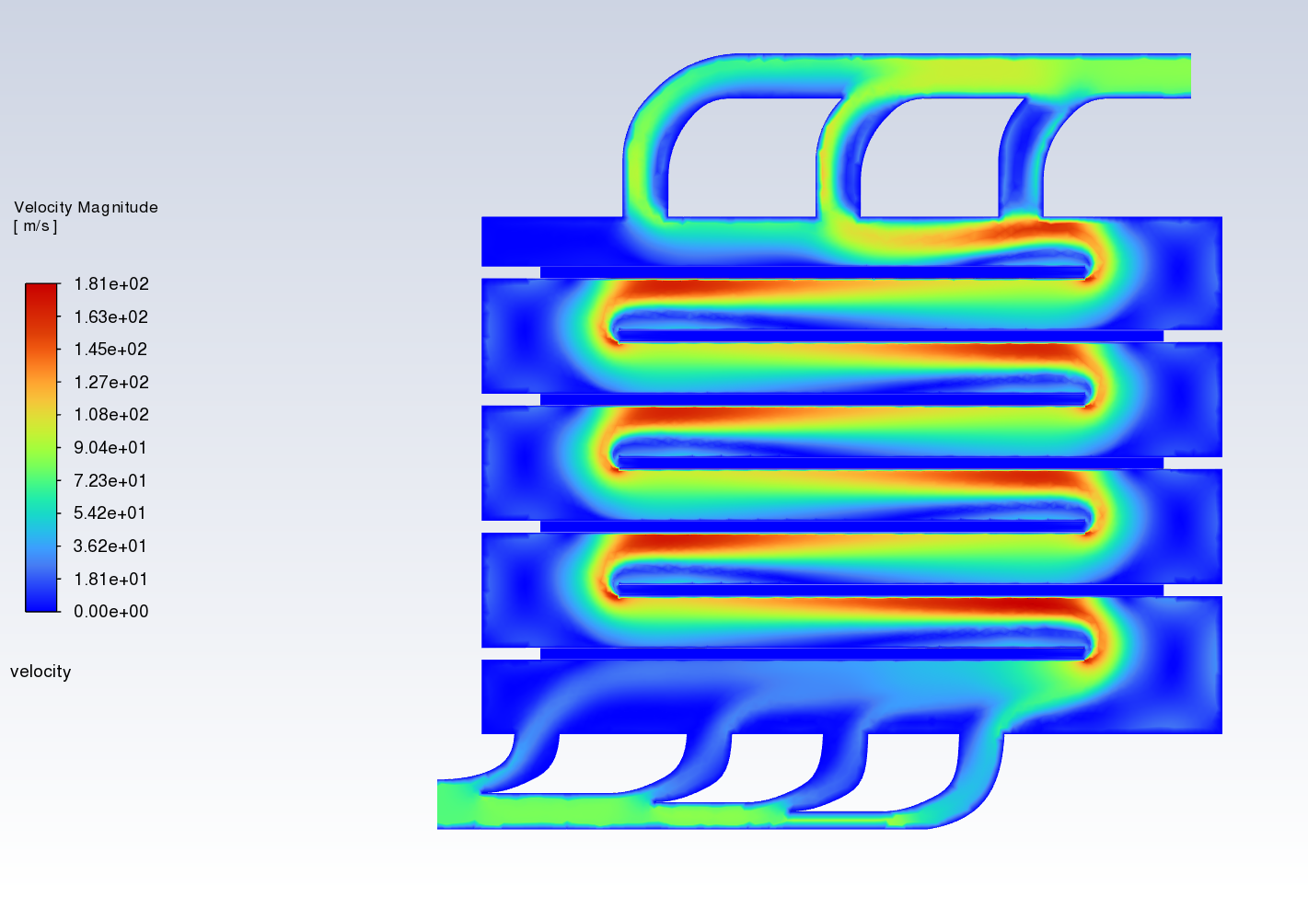
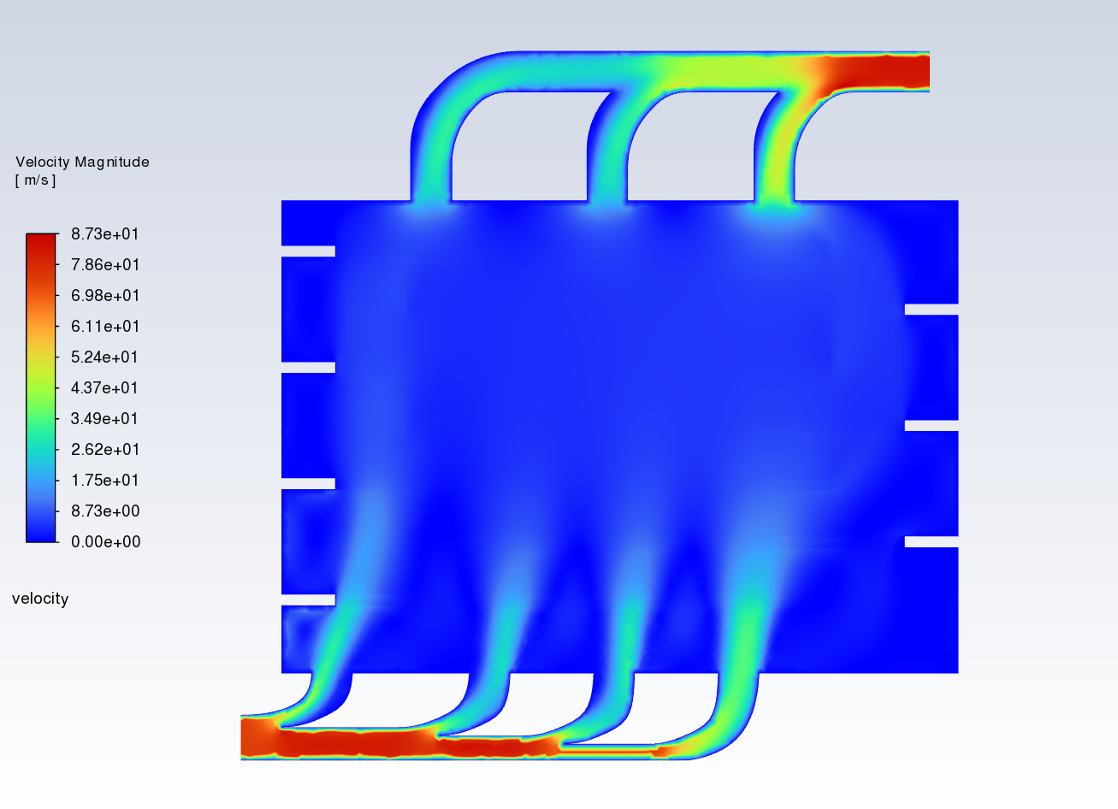
Research Projects
Design and Optimization of a Conveyor-Style Dehumidifying Chamber
Objectives:
Design a multi-stage conveyor-style dehumidifying chamber for continuous operations.
Optimize airflow and temperature distribution to achieve uniform drying.
CFD Solver: ANSYS Fluent for flow analysis.
Parameters Analyzed: Air velocity, temperature gradients, humidity levels, and residence time.
Key Results and Progress:
Developed 4 possible inlet/outlet configurations that have passed approval from the company.
Achieved uniform flow velocity across the conveyor length with less than ±2% variation.

Slide 8
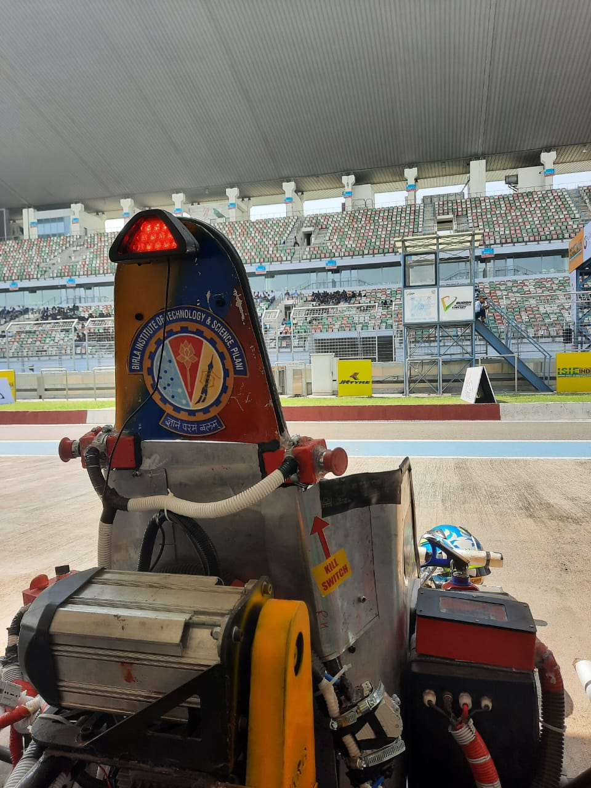
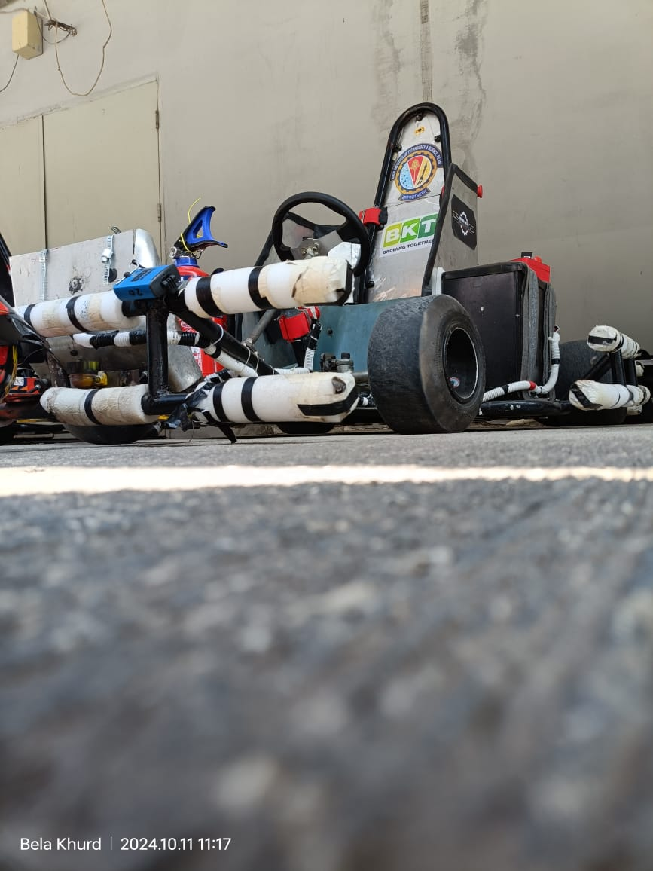
Team Projects
Inspired Karters Gravity
Description:
Spearheaded a team of 50+ members, focusing on designing and manufacturing an electric go-kart.
Managed budget of INR 1000K+ and raised INR 400K+ in team funding.
Key Results and Progress:
Secured an All-India Rank 10 in the Electric Category at the national-level go karting competition.
70 km Range & 110 kmph top speed.
Secured 1st Place among 237 participants in a prototype presentation competition and was awarded a cash prize of INR 35K.

Slide 9
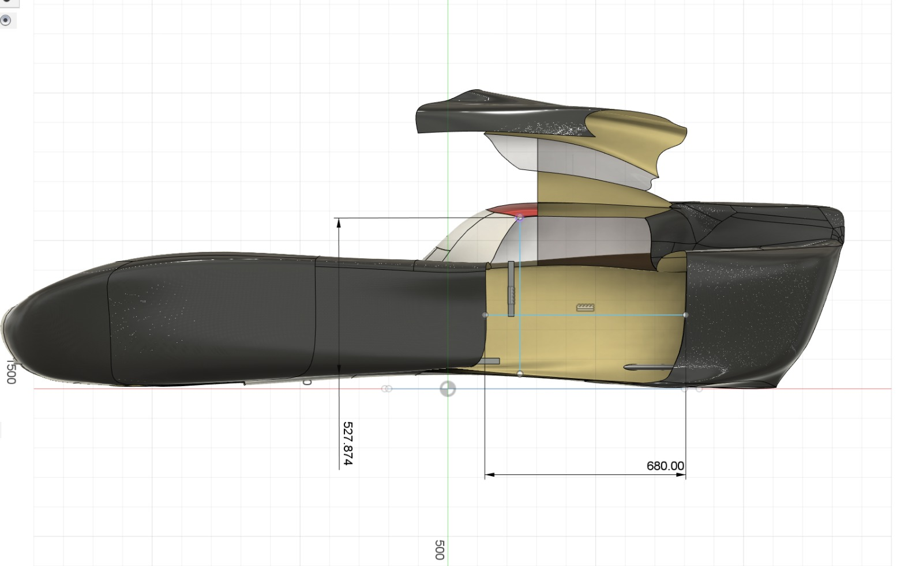
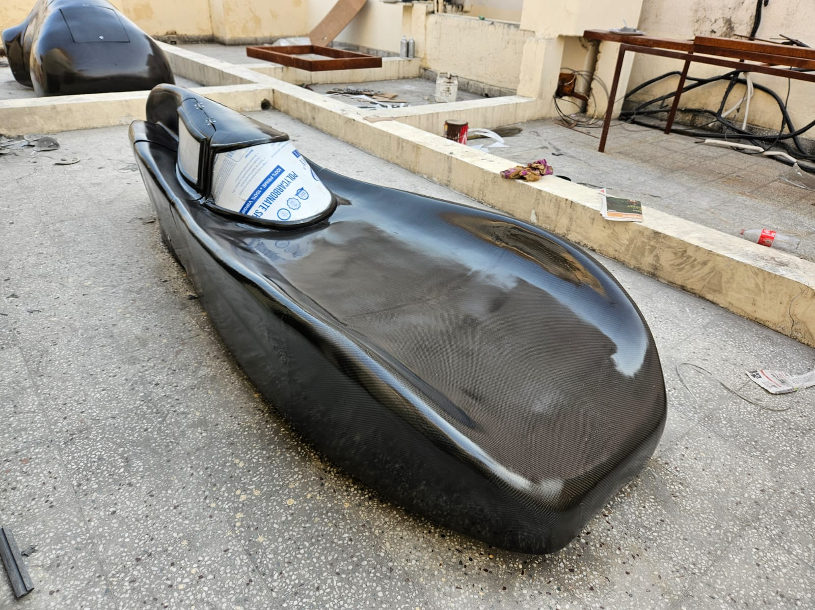
Team Projects
Team BITS – Shell Eco-Marathon
Description:
Designed spaceframes for 100% ethanol-run and electric cars for Shell Eco-Marathon Asia-Pacific.
Assisted in designing the carbon fiber aero package for a prototype vehicle, achieving a drag coefficient of 0.18, reducing air resistance and enhancing performance.

Slide 10
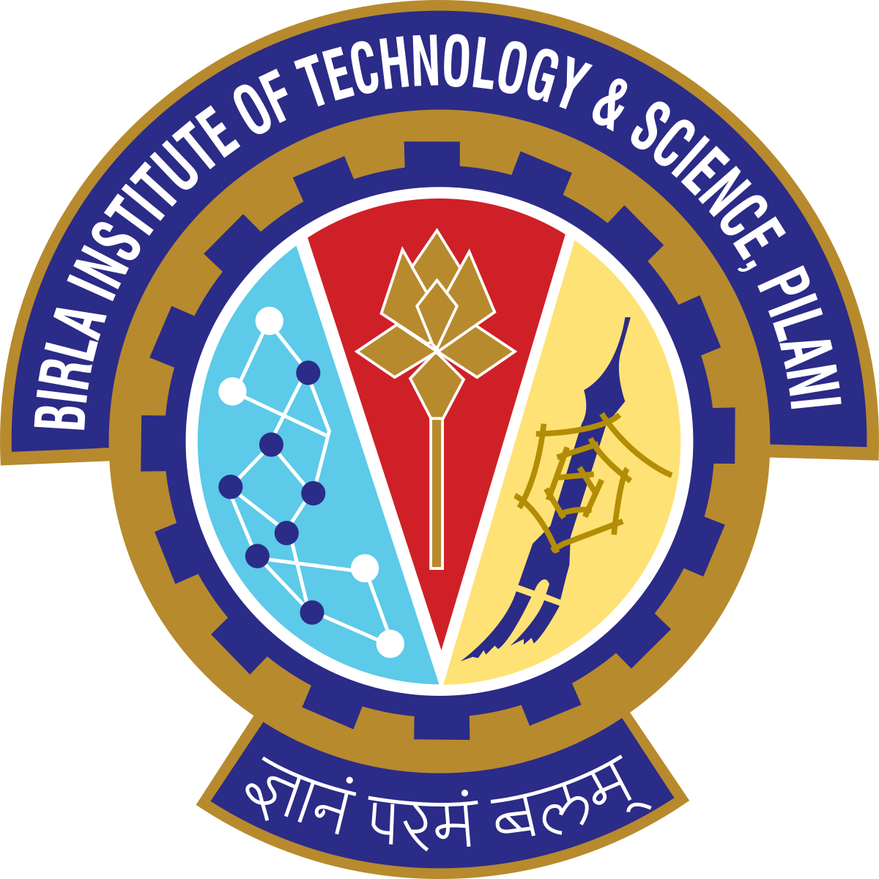
Skills
Numerical Modelling:
ANSYS Fluent, ANSYS Structural, Basilisk, OpenFoam, SimScale, and XFLR.
CAD/CAM:
SolidWorks, Fusion 360, Creo Parametric, AutoCAD, and OpenVSP.
Programming:
Python, C++, MATLAB, C, Basilisk C, and LaTeX.
Microsoft Office:
Excel, PowerPoint, Word
Research and Communication:
Leadership and Team work
Effective communication
Conference presentation and academic reporting
Languages:
English, Telugu, Hindi

Slide 11
Academic Coursework
Core Discipline Courses
Humanities and others
2nd Year:
Fluid Mechanics
Heat Transfer
Applied Thermodynamics
Mechanics of Solids
Advanced Mechanics of Solids
Material Science
Manufacturing Processes
Mechanisms and Machines
3rd Year:
Computational Fluid Dynamics
Finite-Element Methods
Gas Dynamics
Numerical Fluid Flow and Heat Transfer Techniques
CAD
Prime Movers and Fluid Machines
Engines, Motors, and Mobility
Manufacturing Management
Advanced Manufacturing Process
Vibrations and Control
Design of Machine Elements
Engineering Optimization
Business Communication
Human Resource Development
Print and Audio-Visual Advertising
Principles of Economics
3 project type courses
Tanish Samanta, Gokula Krishna Tavva, Chennu Ranganayakulu

